Slide 1
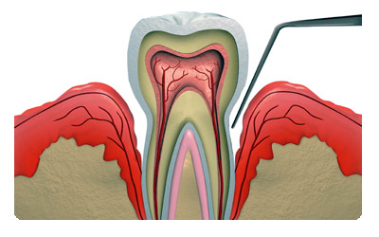
ENDODONTIC – PERIODONTIC RELATIONS - CLASSIFICATION & ITS MANGEMENT

Slide 2
COMMUNICATION LINKS
Vascular routes
Furcation canals
Lateral canals
Apical foramen

Slide 3
COMMUNICATION LINKS
Avascular routes
Denuded cementum
Dentinal tubules
Developmental absence
of cementum at CEJ
Iatrogenic
(root planing)
Palato gingival groove

Slide 4
COMMUNICATION LINKS
Trauma
Vertical root fracture
Posts
RC procedures
Iatrogenic
Root perforation
Internal
Resorption
External

Slide 5
DEFINITION
An isolated, usually narrow, deep probing depth of pulpal or periodontal origin.
Lesion with sub marginal or intrabony periradicular bone loss of pulpal and/or periodontal origin that communicates with the oral cavity via probing defect.
A localized periodontal probing depth of pulpal or periodontal origin.
STOCK

Slide 6
CLASSIFICATION OF PULPO PERIODONTAL DISEASE
Primary endodontic lesion
Primary endodontic with
secondary periodontal
involvement

Slide 7
CLASSIFICATION OF PULPO PERIODONTAL DISEASE
Primary periodontal lesion
Primary periodontal with
secondary endodontic
involvement

Slide 8
CLASSIFICATION OF PULPO PERIODONTAL DISEASE
True combined lesion

Slide 9
WEINE
Type I - Tooth in which symptoms clinically and radiographically simulate periodontal disease but are due to pulpal inflammation
Type II - Tooth that has both pulpal and periodontal disease concomitantly
Type III - Tooth has no pulpal problem but require endodontic therapy plus root amputation to gain periodontal healing
Type IV - Tooth that clinically and radiographically simulate pulpal or periapical disease but infact have periodontal disease

Slide 10
DIAGNOSIS OF PULPO PERIODONTAL DISEASE
Crucial – Diagnosis of origin of pathosis → effective treatment
Scientific knowledge
Clinical experience
Patience
Intusion
Common sense
Accurate diagnosis
Simple – monitored case / records
Complex – No history/ records/ radiographs
Series of tests necessary – to avoid Misdiagnosis

Slide 11
DIAGNOSIS OF PRIMARY ENDODONTIC LESION
Differentiating features:
Pain history
Severe pain – endo involvement
Absence of pain – does not preclude pulp pathosis
2. Swelling - Location
Mucobuccal fold- pulpal
Attached gingiva - periodontal
Facial swelling - pulpitis

Slide 12
DIAGNOSIS OF PRIMARY ENDODONTIC LESION
3. Presence of large restoration,
deep caries, poor RCT etc.
4. Radiographs

Slide 13
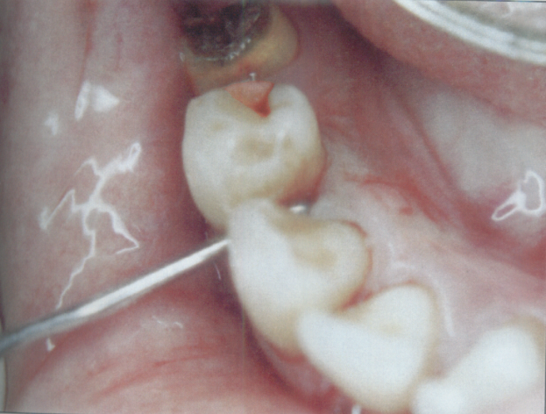
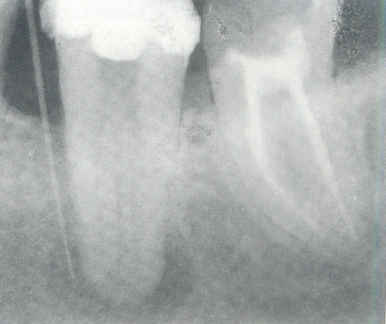
DIAGNOSIS OF PRIMARY ENDODONTIC LESION
5. No periodontal disease in
other areas of mouth.
Minimal to no calculus
6. Tracing of sinus tract – traced to the origin of Pathosis

Slide 14
DIAGNOSIS OF PRIMARY ENDODONTIC LESION
7. Diagnostic probing – most useful adjunct
Probing defects
Perio
Endo
wide – generalised deep
narrow - rapid plunge

Slide 15
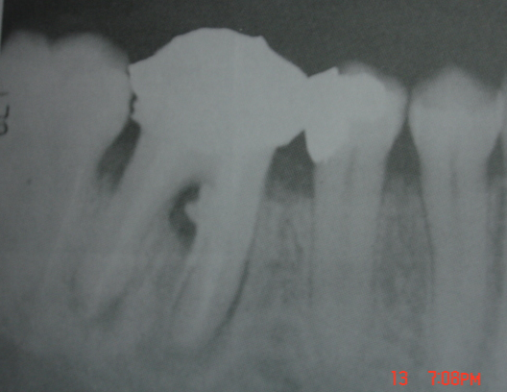
PRIMARY ENDODONTIC LESION
Caries / trauma / restorative procedure
Pulp Inflammation
Apical / lateral / Furcation / Attachment apparatus
Pain , swelling , tenderness , marginal gingiva swelling
Suppurative process – Sinus tract
Pdl / Patent channels Ging. Sulcus
( GP / Probe to apex)
Multirooted Teeth
Gr. III thru & Thru Furcation defect
Diagnosis : Necrotic / Vitality test
Treatment : RCT

Slide 16
MANAGEMENT OF PRIMARY ENDODONTIC LESIONS
Conventional root canal therapy
Resist temptation to do invasive perio therapy
↓
Further damage to attachment
↓
Delay in healing
Healing - spectacular
Prognosis – good and highly predictable
Loss of attachment is reversible
No permanent damage to cementum & fibers

Slide 17
Reasons for failure to heal
Wrong diagnosis
Could be combined lesion
Vertical fracture – common in RCT teeth
Failed RCT
Do not hesitate to re-evaluate & do necessary correction
Failures may occur not just because of us, but inspite of us

Slide 18
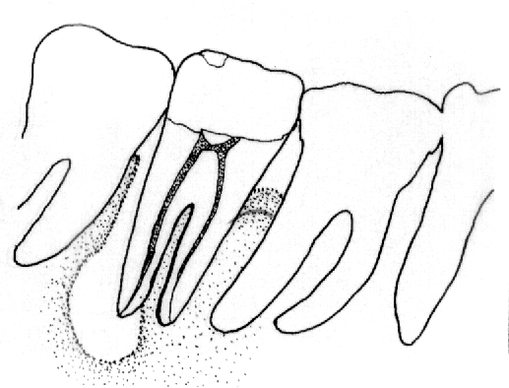
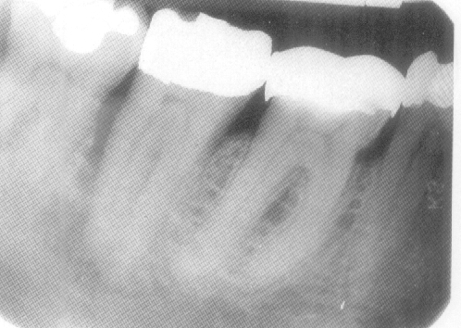
DIAGNOSIS – PRIMARY ENDO – SECONDARY PERIO LESIONS
Long standing pulpal pathosis
Presence of large restoration, pulp cap, deep caries
Super imposition of plaque & calculus.
-ve vitality testing
Radiographic evidence of angular defect at the site of involvement

Slide 19
PRIMARY ENDODONTIC WITH SECONDARY PERIODONTAL
Unchecked endo lesion
Periapical alveolar bone destruction
Interradicular area Hard / soft tissue
Drainage Plaque / Calculus
Apical attachment migration ( perio disease)
Diagnosis : Necrosis / Calculus accumulation
Treatment : Both

Slide 20
DIAGNOSIS OF PRIMARY PERIODONTAL LESIONS
Generalised plaque & calculus deposits
Soft tissue inflammation
Teeth vital
Broad based generalised deep pockets
X-ray – generalised osseous defects
Varying degrees of mobility of teeth
H/O severe pain generally absent

Slide 21
PRIMARY PERIODONTAL LESION
Sulcus Plaque / Calculus Apex
Inflammation
Alv. Bone / Pdl
Clinical attachment loss
acute
Abscess
Lateral root / Furcation / TFO ( isolated lesion ) osseous defects
Diagnosis : Tooth mobility
positive pulp test
Broad based pocket / Plaque & calculus
Generalized
Treatment : Periodontal therapy

Slide 22
MANAGEMENT OF PRIMARY PERIODONTAL PROBLEM
Treatment
Scaling, root planing & curettage
Flap surgery
Regenerative therapy
Resective therapy
Depends on severity & destruction of attachment apparatus
RCT not required
Intentional RCT - when treatment plan is for
hemisection/ radisection

Slide 23
DIAGNOSIS – PRIMARY PERIO & SECONDARY ENDODONTIC LESIONS
Deep periodontal pockets > 6 – 8 mm
H/O extensive perio disease / therapy
No caries/ restoration/ pulp caps of involved tooth
Pain accentuated
Pulp testing –ve
Generalised periodontitis, plaque, calculus, soft tissue inflammation

Slide 24
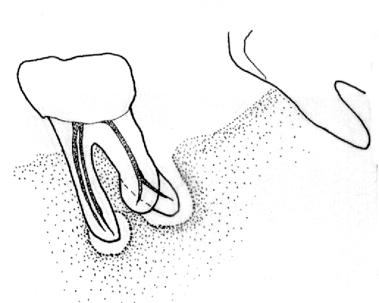
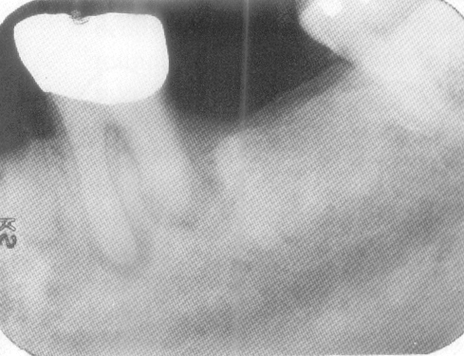
Radiographically severe bone loss extending near to or around the apex
Large areas of periapical distruction can occur without compromising health of the pulpal tissue
Diagnosis is vital to prevent needless devitalisation of teeth

Slide 25
MANAGEMENT OF TYPE II, TYPE IV & TYPE V LESIONS
Type II – primary endo with secondary perio
Type IV – primary perio with secondary endo
Type V – true combined lesion
→ Combined
lesion?
Endodontic component
Easily managed
Highly predictable prognosis
Properly treated
healing predictable
Periodontal component
Difficult to manage
Depends on severity of disease
Type & extent of bone loss
Maintenance by patient
Unpredictable prognosis
Both components need to be addressed

Slide 26
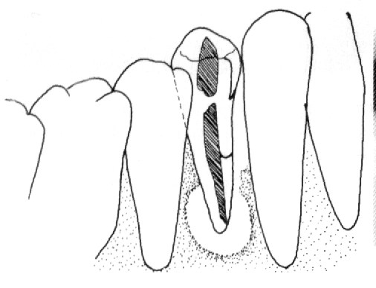
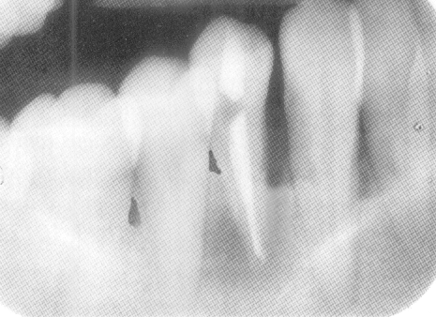
DIAGNOSIS OF COMBINED LESIONS
-ve vitality test
Pain, swelling ..
Presence of caries, restoration, pulp caps
Plaque calculus, soft tissue inflammation
Wide & conical perio pockets
Generalised osseous defects
mobility

Slide 27
MANAGEMENT OF COMBINED LESION
Extent of contribution of periodontal component to bone loss → key factor to treatment planning
> The contribution of perio component
Poorer is the prognosis
How to determine?
Extent of bone loss in other areas of the mouth
Ability to eliminate perio component → determines success of treatment procedure

Slide 28
Sequence of therapy – Endo or Perio?
Endodontic treatment always precedes perio treatment irrespective of the origin of pathosis
Perio lesion fails to heal in the presence of endo infection
Endo lesion heals once RCT is done irrespective of presence or absence of perio lesion
Endo lesion has more predictable prognosis
Presence of Endo infection – risk factor in progression of periodontal disease

Slide 29
Time sequence between Endo and Perio treatment
Lesion of Endo origin or true combined lesion where major contribution to bone loss is because of endo infection
Endo treatment
↓
Phase I perio
↓
2 -3 months
↓
Aggressive perio treatment
Once Endo lesion starts healing – review residual pocket plan appropriate perio therapy

Slide 30
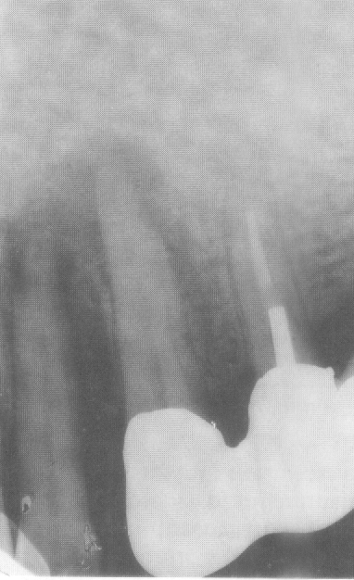
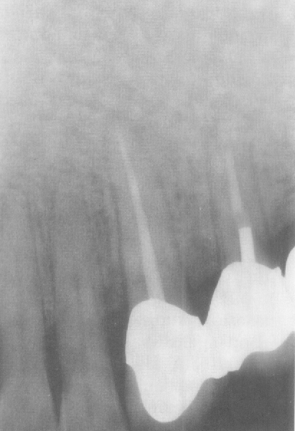
In the absence of definitive diagnosis
In the case of primary endo & secondary perio lesion
Endo treatment first
Wait for 4 – 5 months to see progress in healing
Perio treatment initiated only if required

Slide 31
DIFFERENTIAL DIAGNOSIS
PULPAL
PERIODONTAL
CLINICAL
Cause pulp infection periodontal
Vitality non vital vital
Restorative deep or extensive not related
Plaque /calculus not related primary cause
Inflammation acute chronic
Pockets single and narrow multiple and wide coronally
pH value acidic alkaline
Trauma primary or secondary contributing factor
Microbial few complex

Slide 32
RADIOGRAPHIC
Pattern localized generalized
Bone loss wider apically wider coronally
Periapical radiolucent not related
Vertical bone loss no yes
HISTOPATHOLOGY
Junctional epithelium no apical migration present
Granulation tissues apical (minimal) coronal (larger)
Gingival normal recession
TREATMENT
Therapy RCT Periodontal therapy

Slide 33
SUMMARY OF PROGNOSIS
PRI ENDO
PRI ENDO
SEC PERIO
PRI PERIO
PRI PERIO
SEC ENDO
COMBINED
Excellent
Fairly good
Depends on ability to treat perio disease
Depends on
-Severity
-Ability to
treat perio disease
-Patient compliance
Depends on
-Severity
-Ability to
treat perio disease
-Patient compliance
Depends on
Contribution of endo & perio disease to bone loss
> Endo lesion better the prognosis
Highly
predictable
Some what
Predictable
Unpredictable
Unpredictable
Unpredictable

